Slide 1
Performance analysis polarization reconfigurable circular patch antenna by comparing axial ratio for different polarization state(RHCP,LHCP,LINEAR)

Slide 2
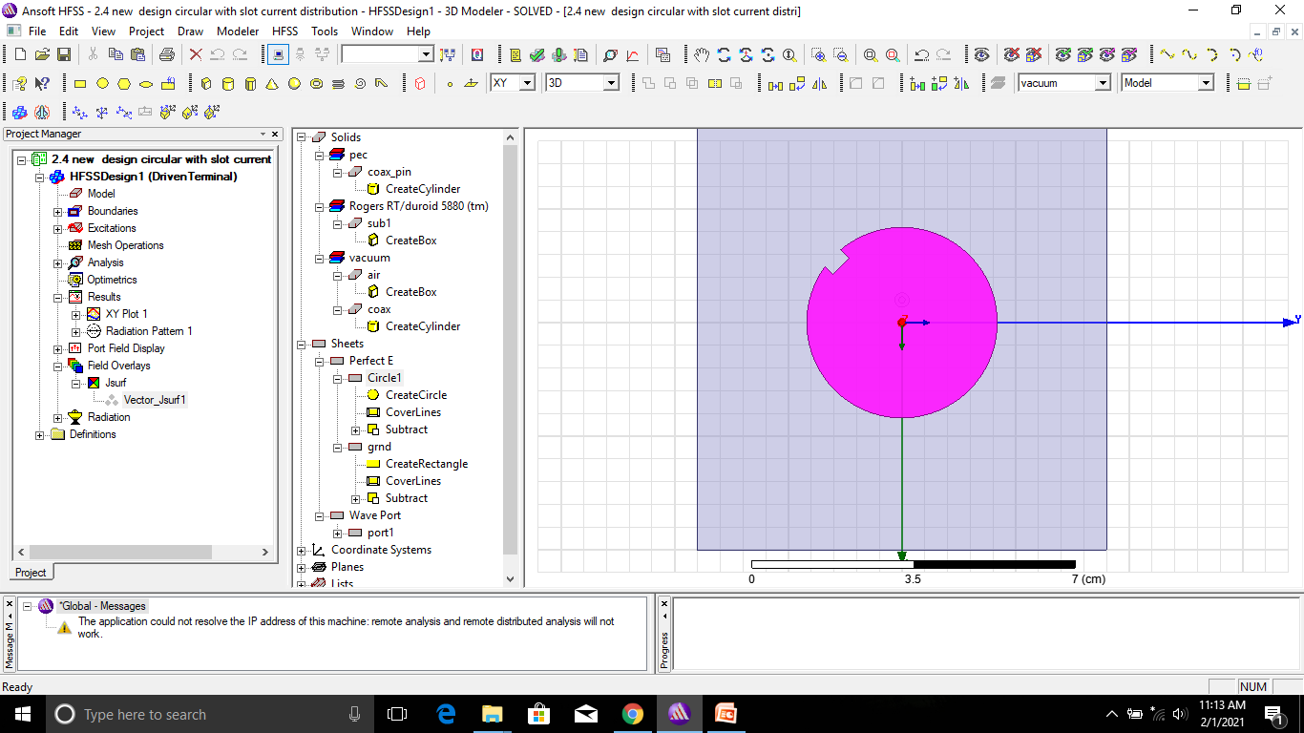
Polarization reconfigurable circular patch antenna with cut

Slide 3
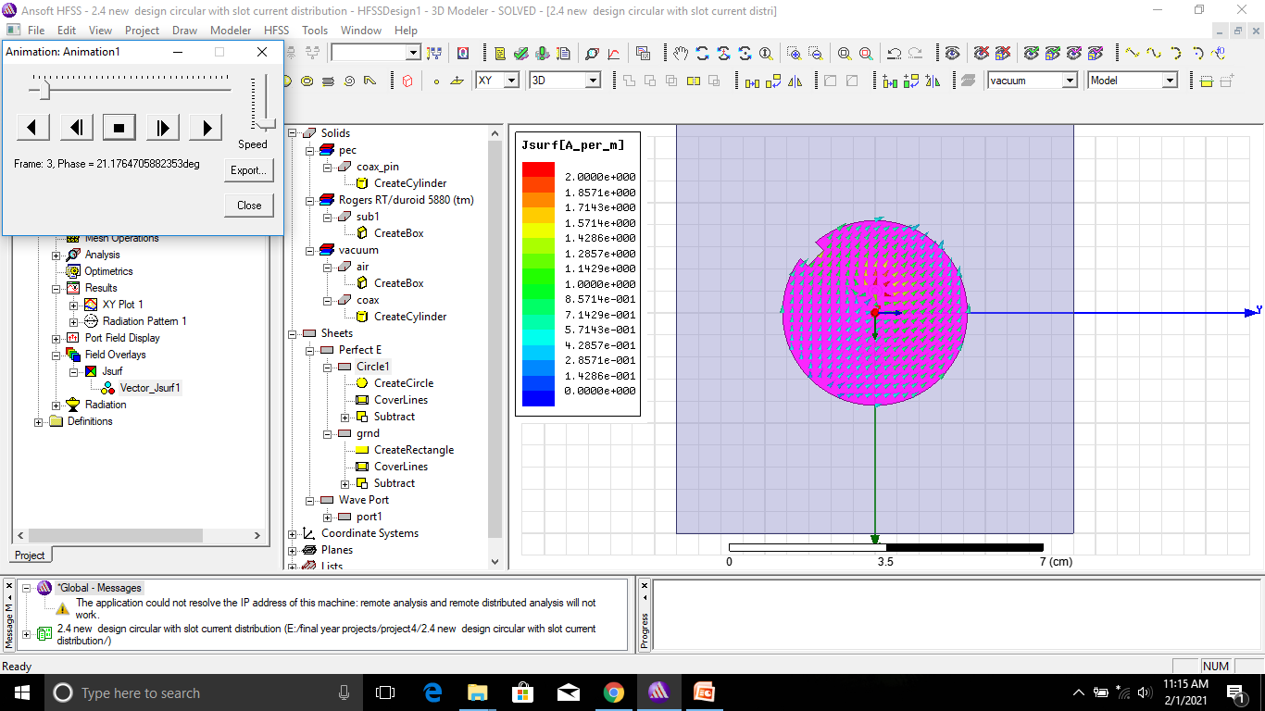
Current distribution clockwise direction

Slide 4
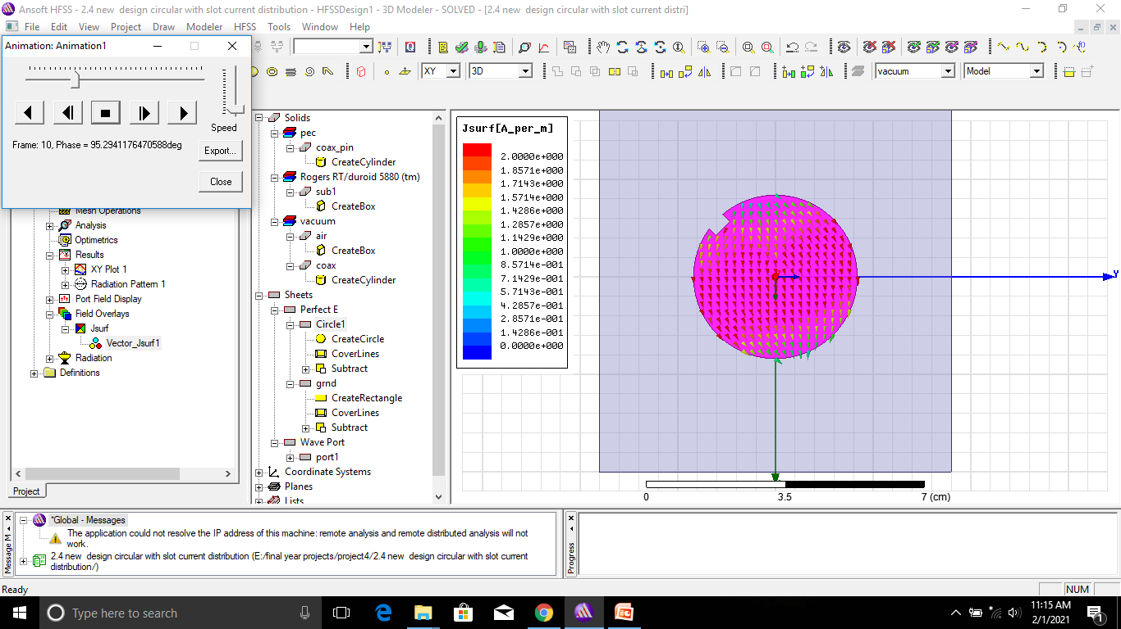

Slide 5
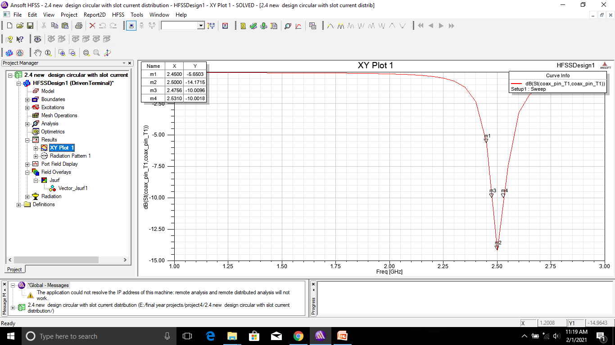
Reflection coefficient

Slide 6
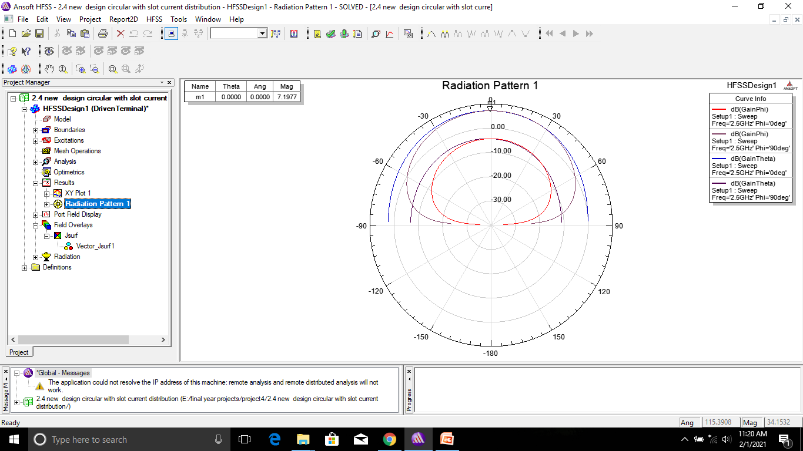
Gain

Slide 7
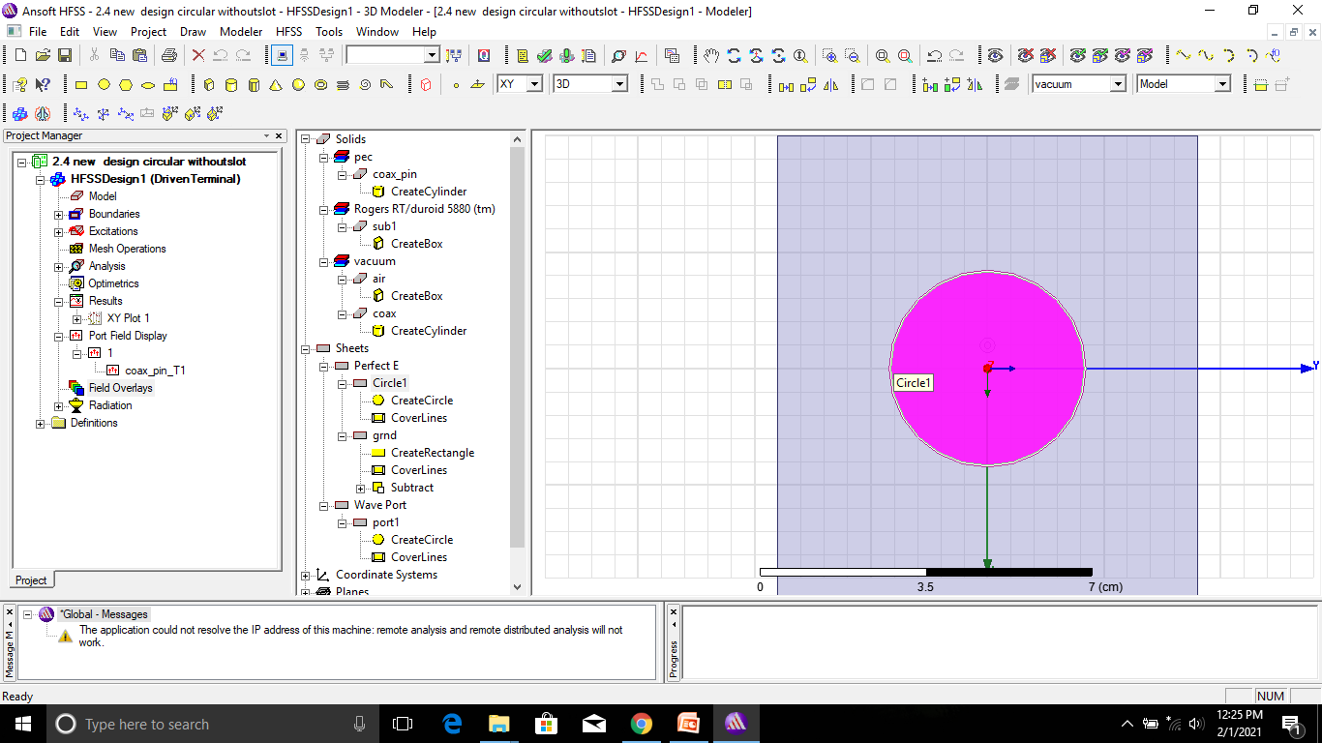
Polarization reconfigurable circular patch antenna without cut

Slide 8
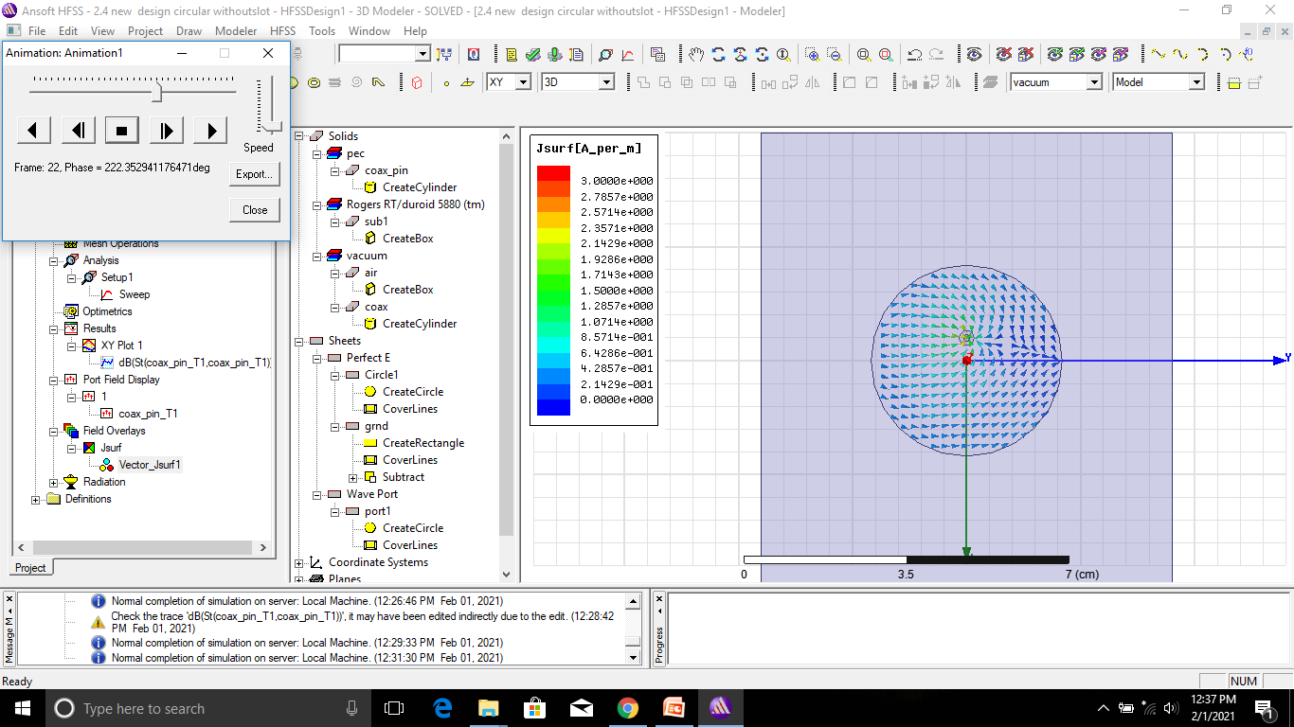
Current distribution anti-clock wise direction

Slide 9
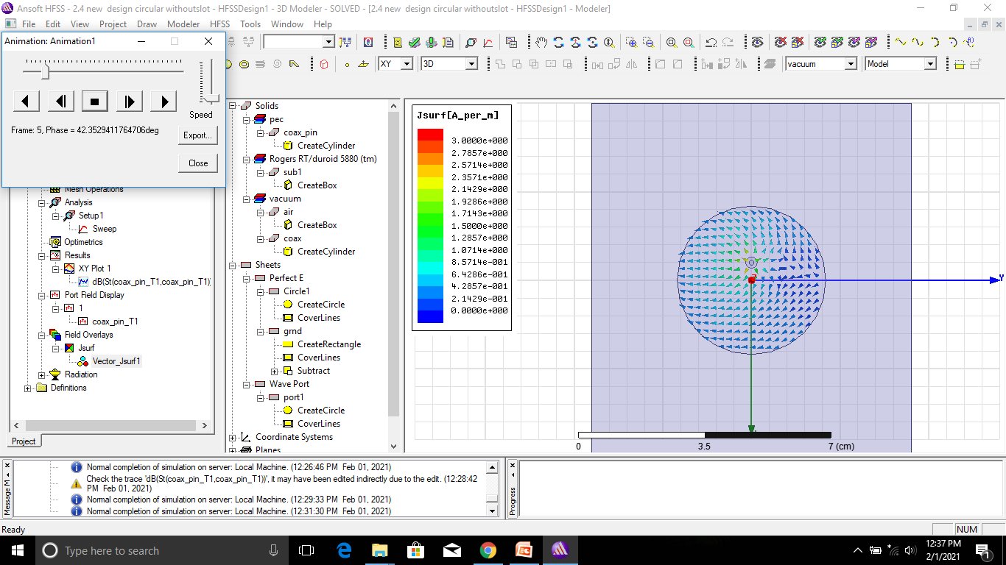

Slide 10
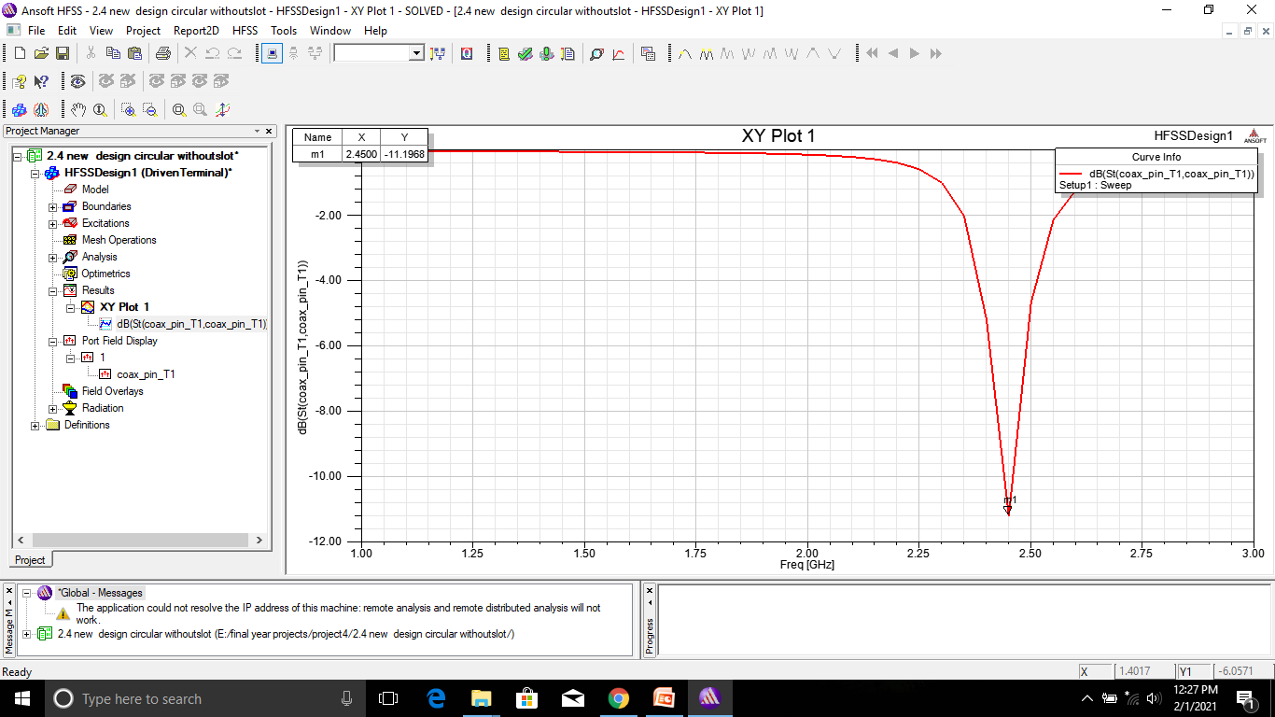
Reflection coefficient

